Slide 1

Object Oriented Programming HTML5 Tutorials Tutorial #2 : Move and rotate a bitmap
Department of Computer Science and Information Engineering
Shuo-Han Chen (陳碩漢), shchen@csie.ntut.edu.tw
Hong-Yue Technology Research Building 1223
F 09:10 - 12:00
Notes:
Good Afternoon everyone
I am Shuo-Han Chen, a postdoctoral research fellow at Academia Sinica
It is a great honor to be invited by the department for being here today

Slide 2

HTML5 Game Framework 使用說明
Tutorial 2: 圖片 旋轉與移動
Notes:
Thank you for listening. Now, I would like to end today’s talk by the Q & A time.

Slide 3
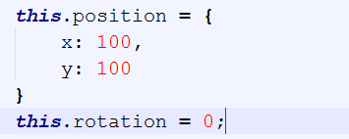
1.請先完成 Tutorial 1
2.打開 game_sample\js 資料夾中的 myGameLevel1.js, 在 load function內宣告 座標和角度 如下

Slide 4
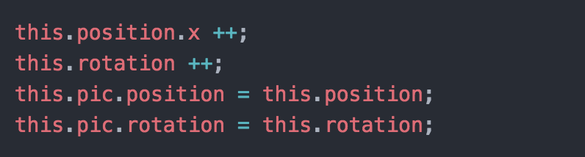
3.在 update function中自動改變圖片的座標與角度

Slide 5
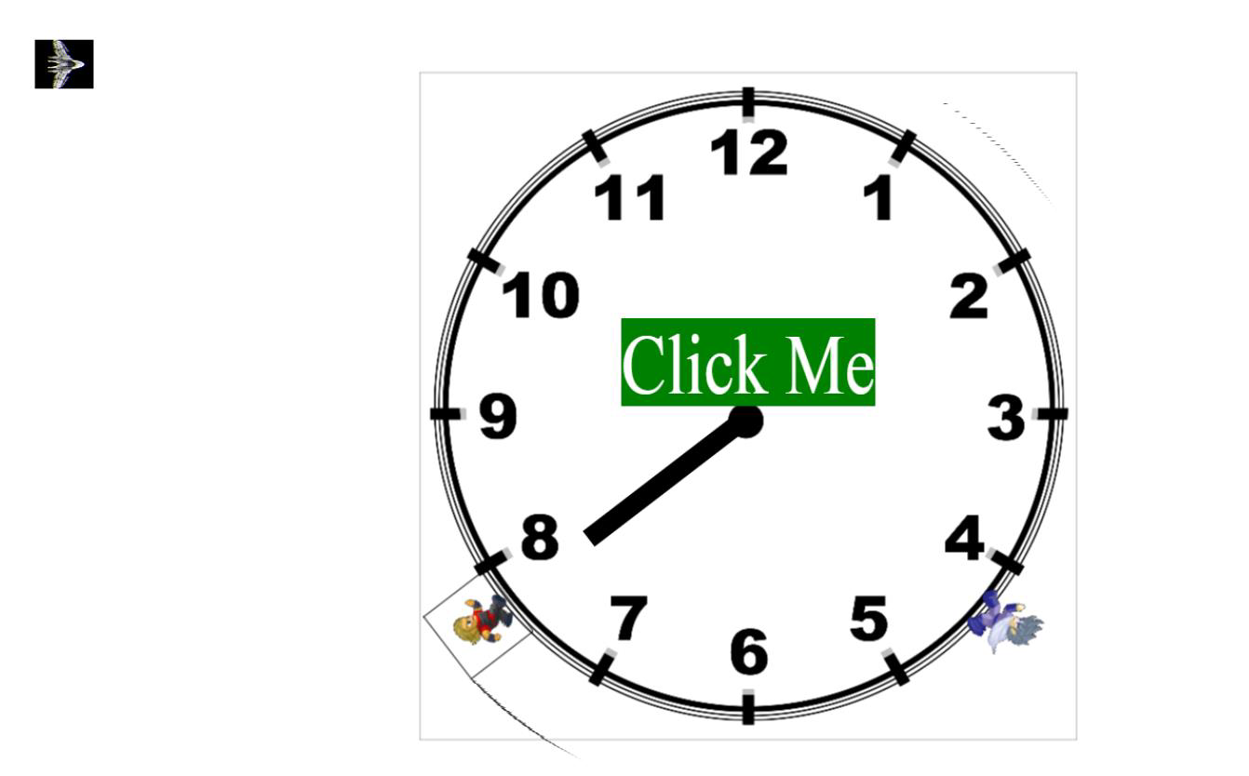
4.執行結果

